Slide 1
Move Instructions
© 2015 John Sefcovic.

Slide 2
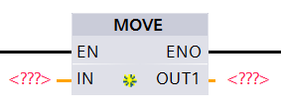
MOVE
The MOVE (MOV) is an output instruction when the rung conditions are true, will place a copy of the IN value, constant or reference Tag, into the OUT Tag.
SIEMENS

Slide 3
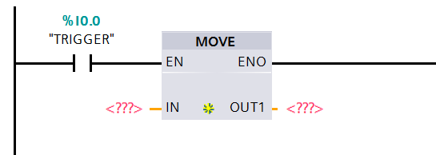
MOVE
When the instruction is first entered, there are two sets of question marks for the IN and OUT values.

Slide 4
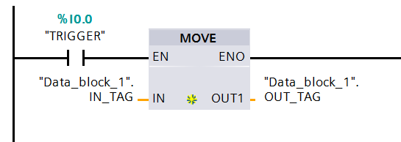
MOVE
Tags are entered for the In and Out pins.

Slide 5
MOVE
When the Tags are entered, the values are not shown.
When Online and Monitored, the Tag values are shown.

Slide 6
MOVE
OPERATIONS
IN
32757
OUT1
BEFORE MOVE
0
OUT1
AFTER MOVE
32757

Slide 7
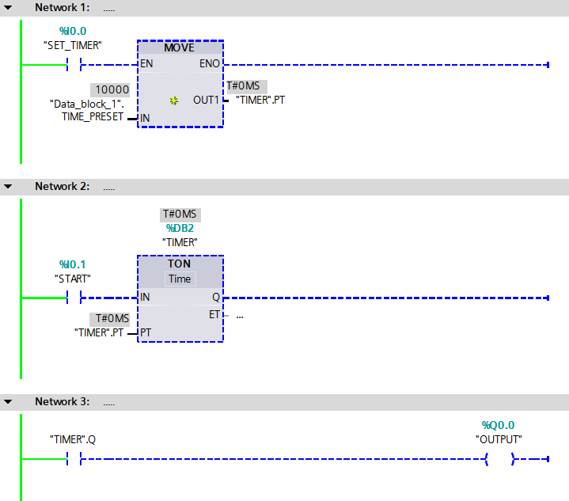
MOVE
The IN is an Integer Tag with a value of 10000.
The OUT is the Timer preset (.PT).
0
10000
OUT
IN
TIMER.PT
TIME_PRESET
0

Slide 8
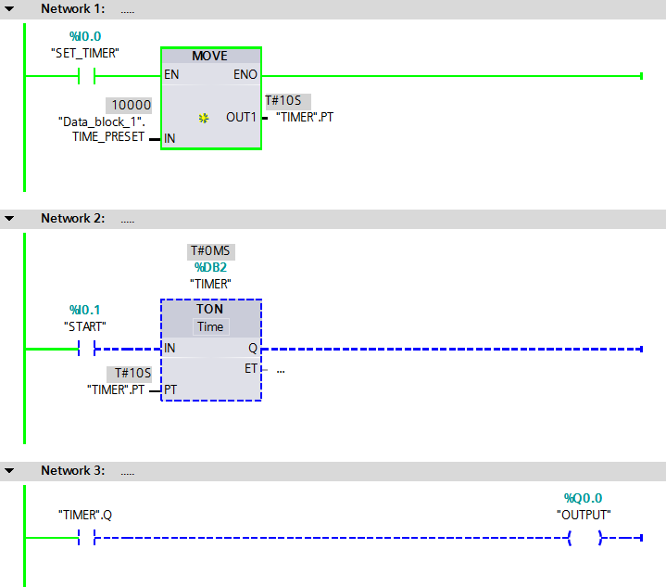
MOVE
When the rung is TRUE, the value of 10000 is moved into the timer’s preset setting the timer to 10 seconds.
10000
10000
SOURCE
DESTINATION
TIME_PRESET
TIMER.PT

Slide 9
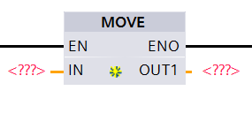
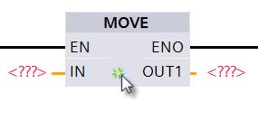
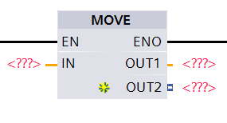
MOVE
The MOVE instruction can have more than one OUT tag.
Place the cursor on the Inset Output marker and left click.
An OUT is added to the MOVE instruction.

Slide 10
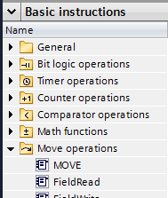

MOVE
The MOVE instruction button is in the Basic Instructions.
SIEMENS

